Slide 1


NXT Light Sensors on the EV3
ADVANCED EV3 PROGRAMMING LESSON
By Lego Works

Slide 2
Goal
The goal of this lesson is to help you use your NXT Light Sensors with your EV3
The main purpose of the code is to calibrate your NXT sensors
Thank you to FLL Team Lego Works from PA for sharing this lesson with us
Please note that you will need to understand FILES to use this code. We will add a lesson on this topic soon.

Slide 3
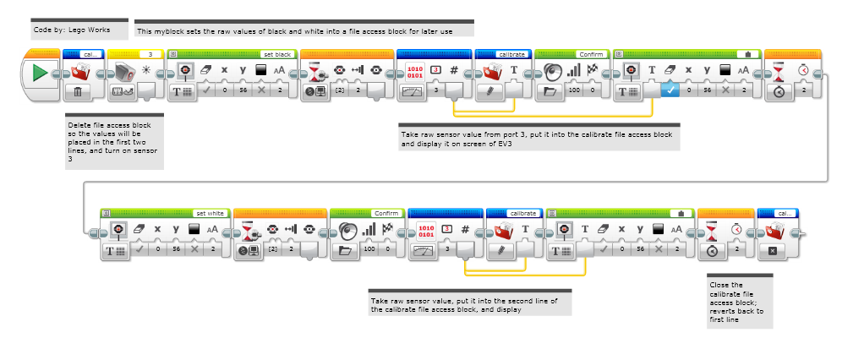
STEP 1: CALIBRATE_LS: Store Black/White Readings to FILES

Slide 4
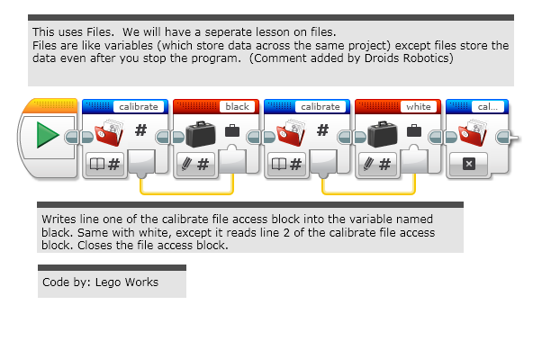
STEP 2: VARIABLE_SET: READING THE VALUES into Variables

Slide 5
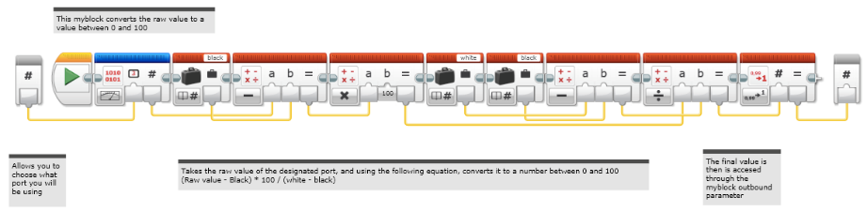
STEP 3: LIght_sensor: Normalize the Light Sensor Readings to 0-100

Slide 6
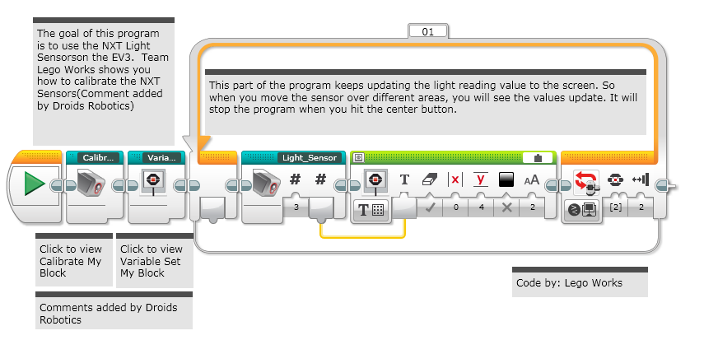
STEP 4: TEST Loop: Calibrating and Reading

Slide 7
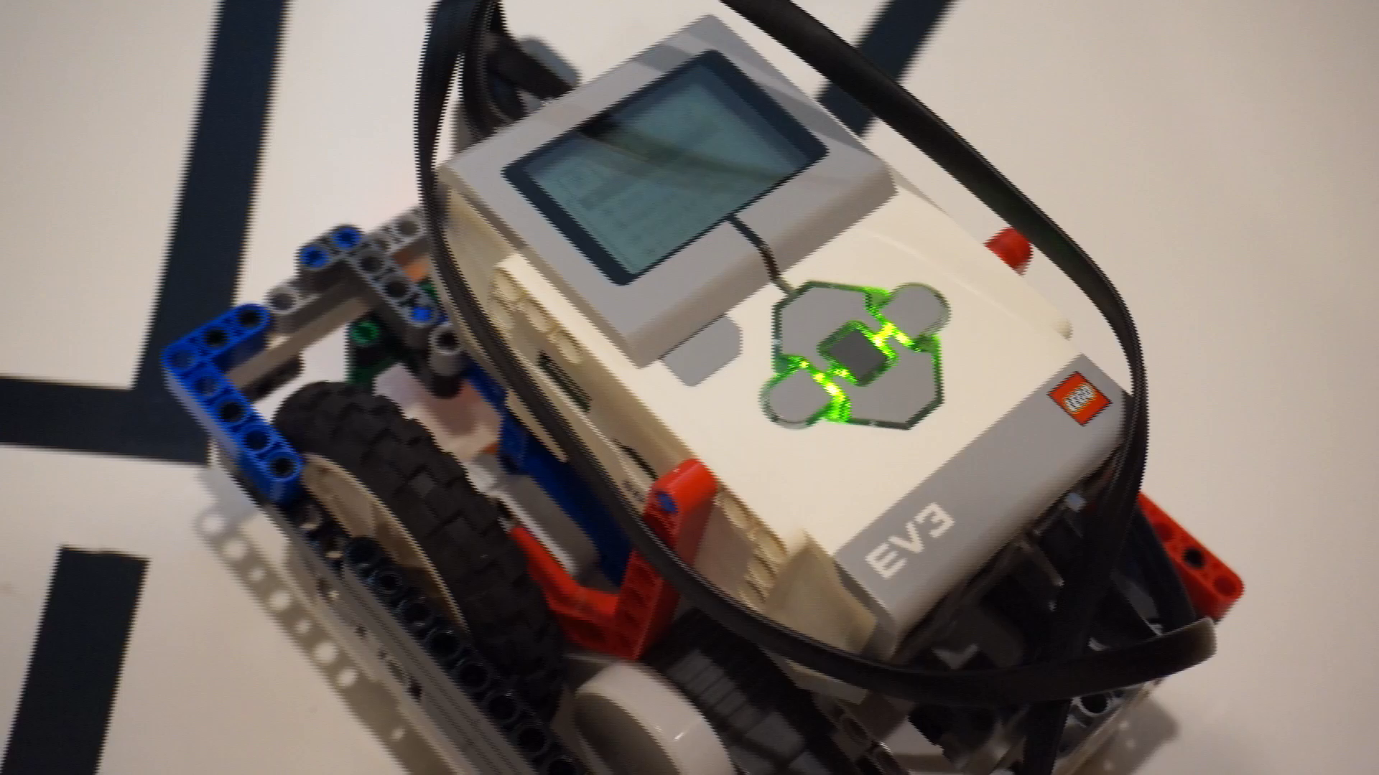
Video Of Running the PROGRAM
Watch this video to see how this code works.

Slide 8
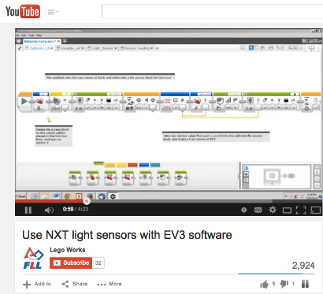
YouTube Version of the Same Tutorial
For this lesson, we have an added bonus: a YouTube companion lesson…
Visit
https://www.youtube.com/watch?v=I7Bqvk-uMLk

Slide 9

Credits
This tutorial was compiled by Sanjay Seshan and Arvind Seshan from Droids Robotics using code shared by Lego Works (legoworks2013@gmail.com)
More lessons at www.ev3lessons.com
This work is licensed under a Creative Commons Attribution-NonCommercial-ShareAlike 4.0 International License.

